Slide 1

Movie Recommender System
Presented By:
Vedant Narendra Joshi
University ID:
801305907

Slide 2
Why this topic?
The Problem Statement
Due to overwhelming amount of options available on the internet, it is necessary to filter, organize and effectively distribute relevant information in order to address the issue of excess information that many internet users have been experiencing.
Recommender systems try to mitigate this problem of having huge options by filtering out the right content for them.
Similar to this, when we talk of entertainment, we think about movies. The internet has tens of thousands of films from various eras. Users sometimes struggle to decide what to watch, thus it is advantageous to develop a movie recommendation system based on user ratings, genres, preferences and other factors.
In this project, I’ll explore several different algorithms on the MovieLens Dataset and analyze which one provides the most accurate recommendation.

Slide 3
The Problems and Challenges
Scalability: In many of the environments in which these systems make recommendations, there are millions of users and products. Thus, large number of computation power is often necessary to calculate the recommendations.
Sparsity: The number of movies watched on major OTT platforms is extremely large. The most active users will have rated a small subset of the overall database. Thus, even the most popular movies may have very few ratings.
Cold Start: These systems often require a large amount of existing data on a user in order to make accurate recommendations
Cold start
Sparsity
Scalability

Slide 4
The Motivation
We frequently favor items that are comparable to other things we enjoy.
We also prefer to like items that people who are similar to us like.
These patterns can be utilized to create predictions about future developments.
These advances can be managed with the use of recommendation systems.

Slide 5
The Data [3]
Dataset Name: MovieLens 100K Dataset
Dataset Description: The dataset Consists of following features:-
1) 100,000 ratings (1-5) from 943 users on 1682 movies.
2) Each user has rated at least 20 movies.
3) Simple demographic info for the users (age, gender, occupation, zip)
Dataset Link: https://grouplens.org/datasets/movielens/100k/

Slide 6
The Existing Approach [1]
Data pre-processing becomes challenging due to the enormous amount of data that is available to us in the data.
To mitigate this problem, The Singular Value decomposition approach for dimension reduction is introduced in approach that follows.
For the classification of the movies into classes and for its further distribution after Recommendations, KMeans Clustering Method was used.
Metrics like the standard deviation (SD), root mean square error (RMSE), mean absolute error (MAE), t-value, Dunn index, average similarity, and calculation time were used to evaluate the model.
The findings achieved using the above method are shown on the next slide.->

Slide 7
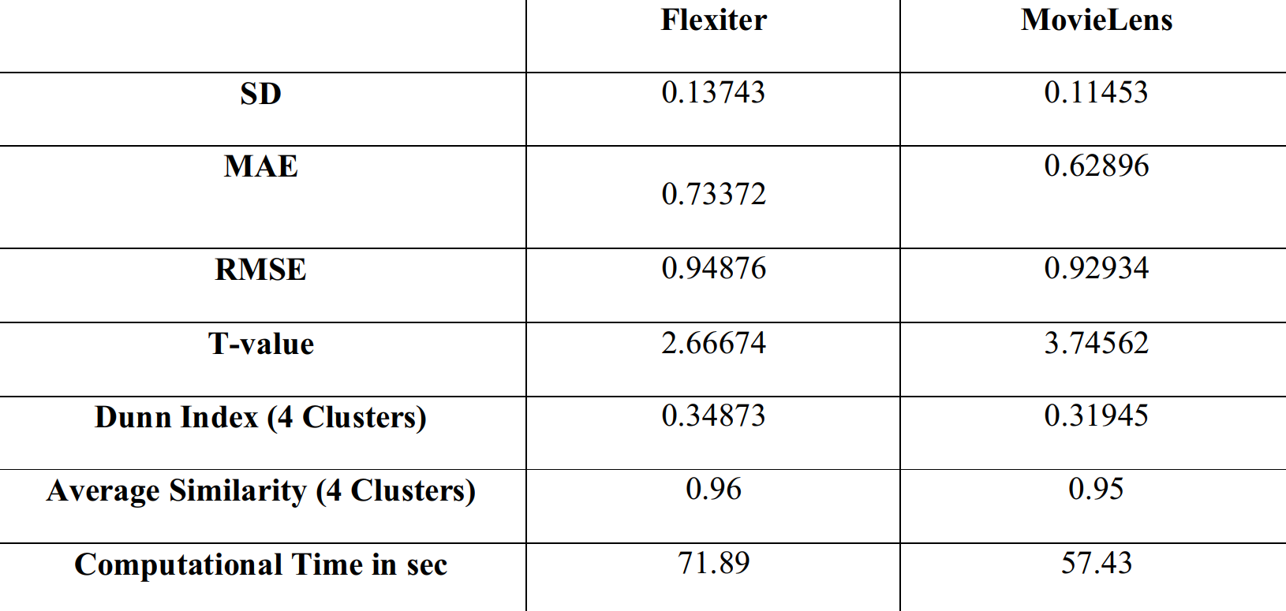
Continued Approach [1]
Two Datasets, Flexiter and MovieLens were compared on the following Metrics and computation time was calculated.
Through Average Similarity the highest accuracy was obtained.
Following is the Graph plotted comparing the 2 Datasets.

Slide 8
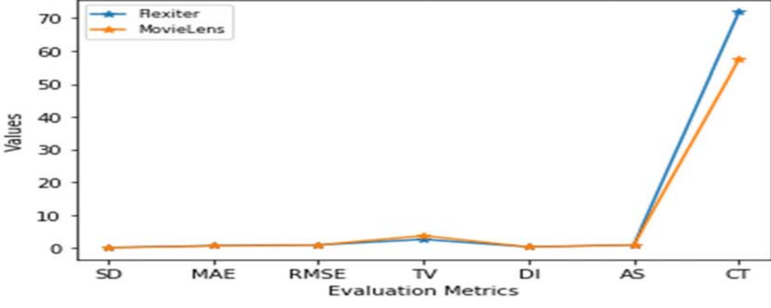
Continued…
The approach involving SVD and KMeans perform’s well on the MovieLens Dataset than the Flexiter Movie Dataset.

Slide 9
The Existing Approach [2]
Recommendation system is of 2 types namely, Collaborative Filtering and Content Based Filtering.
In this research paper, the authors have used a Collaborative filtering Technique for their Recommendation system.
Similar to everything, Data pre-processing and classification needs to be performed by any system.
For this purpose, the authors have designed their data preparation and data analysis using Apache Mahout.
The findings achieved using the above method are shown on the next slide.->

Slide 10
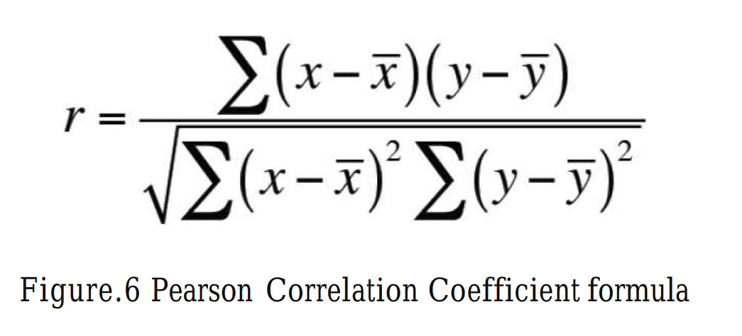
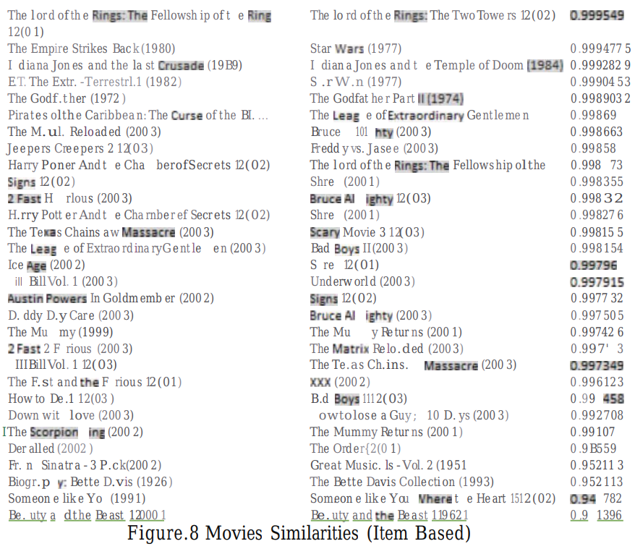
Continued Approach[2]
With the Apache Mahout framework, the MapReduce helps match recommendations to similar Movies.
The Similarity of the movies was calculated using the Pearson Correlation Coefficient.

Slide 11
Methodology – Part 1
Initially, we load the MovieLens Dataset using the pandas Library.
The Dataset is divided into 2 parts, namely, the movie Data and the user ratings.
The dataset is not separated initially, so we first separate the data so we can use it for further process.
The dataset was not separated, hence for this part, I separated the files using pd.read function and encoding techniques.
Since the dataset is big, I did a lot of data visualization to view any discrepancies and ambiguities.
Graphs using matplotlib were plotted for the visualization.

Slide 12
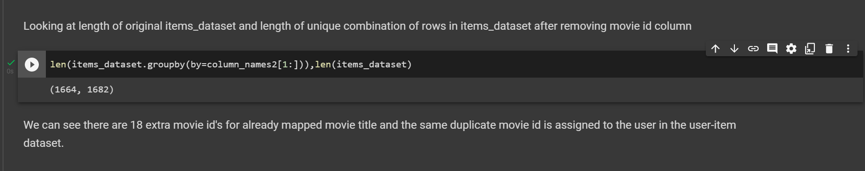
Methodology – Part 2
The project was run without clearing the multiple entries in the dataset.
I cleaned the data by removing the multiple entries and created a refined Dataset.
This gave a clearer picture in the analysis of the data.

Slide 13
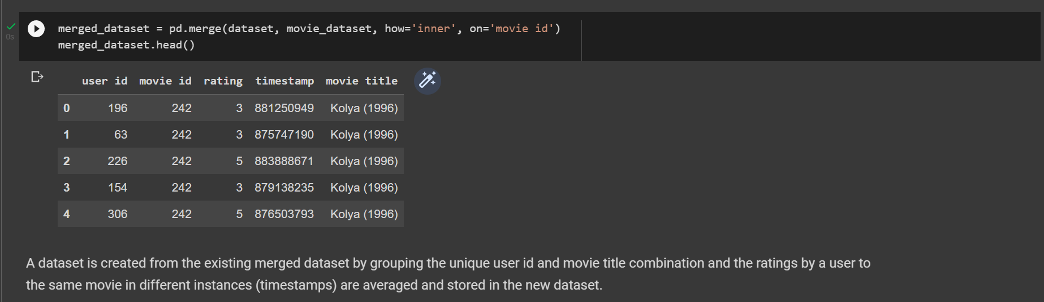
Methodology – Part 2, continued…
Example of newly created Dataset by merging.

Slide 14
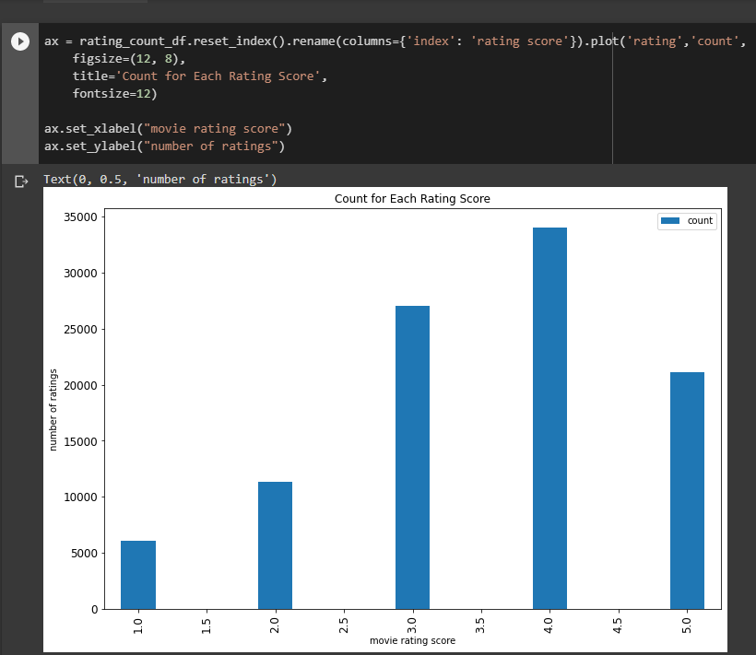
Methodology – Part 3, Exploratory Data Analysis
After Data Cleaning, we have plotted the user ratings against the number of ratings.
We can see that number of 1.5, 2.5, 3.5, 4.5 ratings by the users are comparatively negligible.

Slide 15
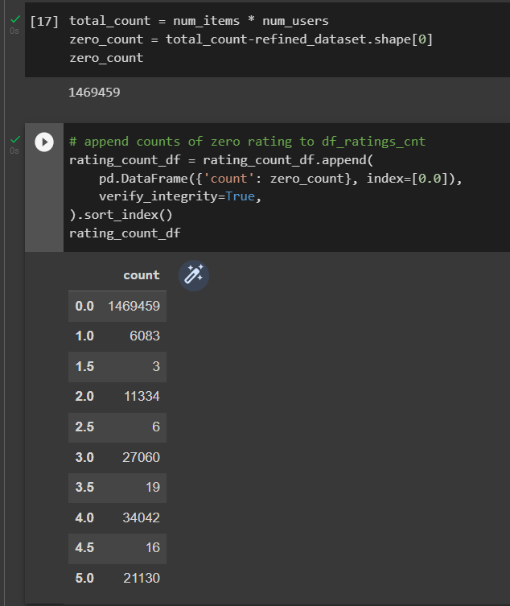
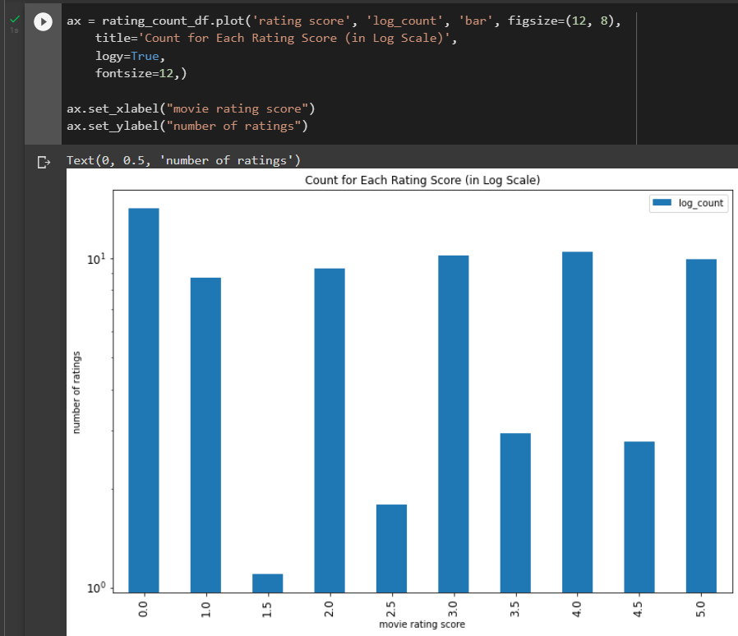
Methodology – Part 3, Exploratory Data Analysis, continued…
Ratings for the movies not seen by a user is by default considered as 0.
We added that to the existing dataset and observed the following graphs.
As the number of 0 ratings is tremendously huge. It creates a sparsity in our dataset and hence a lot of computation power is required.
To mitigate this problem, we log transform the dataset and plot the graph.

Slide 16
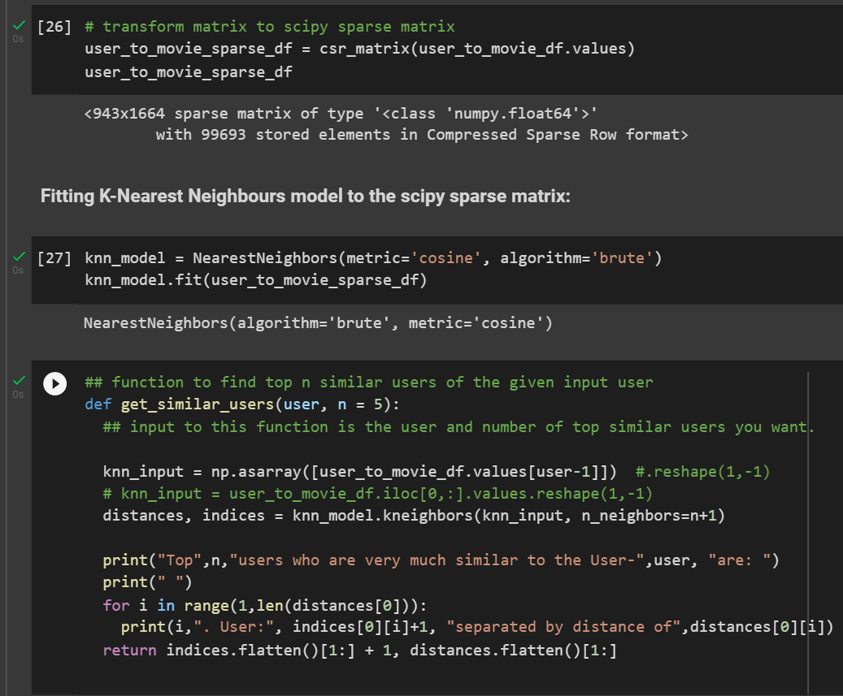
Methodology – Part 4, Creating a KNN Model.
After the Data Cleaning & Exploratory Data Analysis, Its time to create a KNN model using a Cosine similarity metric for making recommendations. We convert the dataset into a SciPy sparse matrix to reduce the computation effort.

Slide 17
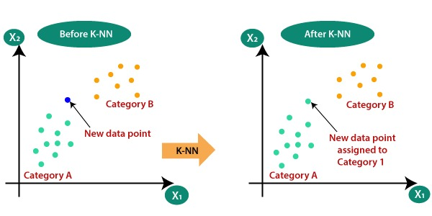
The Algorithm. -> KNN (K Nearest Neighbors)
K Nearest Neighbor is a simple algorithm that maintains all available examples and classifies fresh data or cases based on a similarity metric. It is usually used to classify a data point based on how its neighbors are categorized.

Slide 18
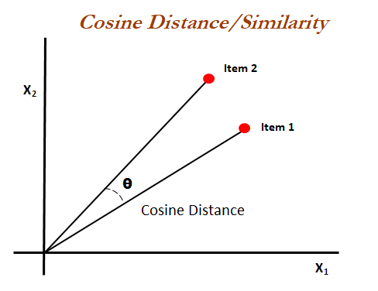
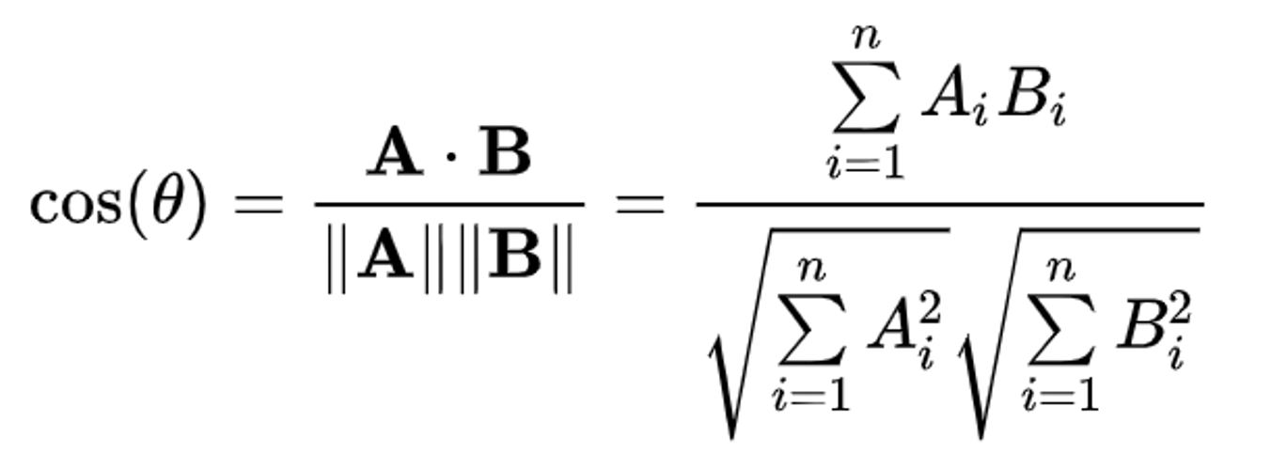
The Mathematics Used. -> Cosine Similarity
Cosine similarity is a metric used to determine how similar the documents are irrespective of their size.
Mathematically, Cosine similarity measures the cosine of the angle between two vectors projected in a multi-dimensional space.
A . B = product (dot) of the vectors ‘A’ and ‘B’.
||A|| and ||B|| = length of the two vectors ‘A’ and ‘B’.
||A|| * ||B|| = cross product of the two vectors ‘A’ and ‘B’.

Slide 19
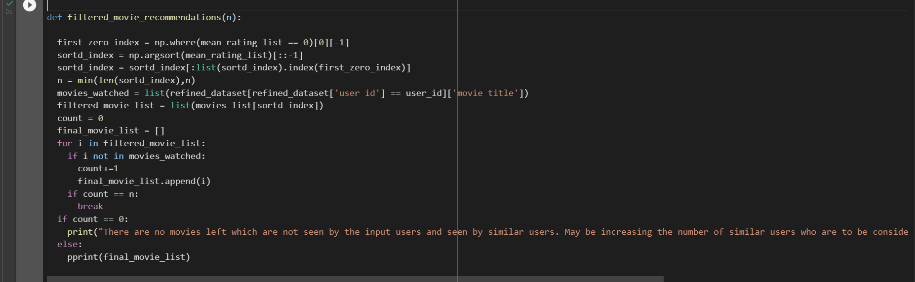
Methodology – Part 5, Fine tuning the Model.
The model had a drawback that it recommends movies which are already seen by the given input user.
To mitigate this problem, a function was built to clear out movies which were already rated.

Slide 20
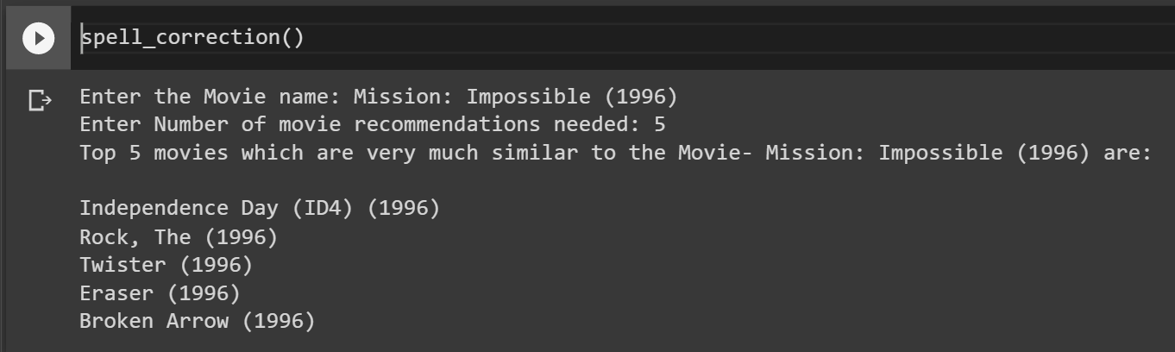
Results.
After all the required changes have been made, we create a function which contains all the other function and call it to make the recommendations.
Following is the final output of our project.

Slide 21
Conclusion.
The Movie Recommender system was successfully implemented.
The KNN Algorithm worked very well with the Cosine Similarity Metric.
For more accurate Recommendations, we will need more ratings and less sparse data.
Huge amount of sparse data can hamper the model generalization.
To mitigate this problem, a log transform worked the best on the given dataset.

Slide 22
Future of the System.
When we don't have enough ratings for a movie or when a user's rating for a movie is very high or low, the cosine similarity computation fails. Other approaches, such as modified cosine similarity, can be used to compute similarity as an upgrade on this project.
Neural Networks and Deep Learning have been popular in a variety of disciplines in recent years, and it appears that they can also be used to solve recommendation system challenges.

Slide 23
References.
[1] Mayur Rahul et al 2021 IOP Conf. Ser.: Mater. Sci. Eng. 1022 012100,” Movie Recommender System using Single Value Decomposition and K means Clustering”
[2] Wu, Ching-Seh & Garg, Deepti & Bhandary, Unnathi. (2018). Movie Recommendation System Using Collaborative Filtering. 11-15. 10.1109/ICSESS.2018.8663822.
[3] https://grouplens.org/datasets/movielens/100k/

Slide 24
THANK YOU!

